Slide 1





Introduction to
GDG On Campus
SSIU

Slide 2

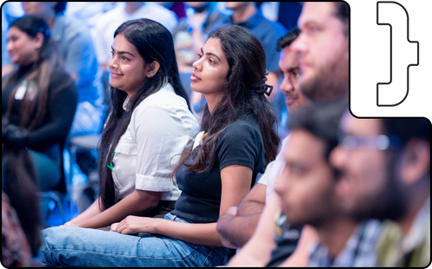

A community that connects developers and technologists to learn, share, and collaborate. GDGs are focused on Google's technology. GDGs can be formal or informal, and can include events like code sprints, hackathons, and tech talks.
GDGs on Campus are for aspiring developers in universities and colleges, and help them gain experience and build a foundation for a tech career.

Slide 3



Slide 4
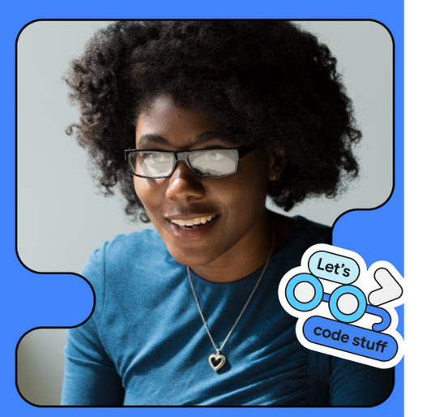
What is a Community?
A group of like-minded individuals collaborating to share knowledge, grow, and innovate.
Importance of a Tech Community:
Learning Together:
Opportunities:
Collaboration:
Innovation:
Why Join?
Get hands-on experience, access resources, and build your network while contributing to a thriving tech ecosystem!

Slide 5
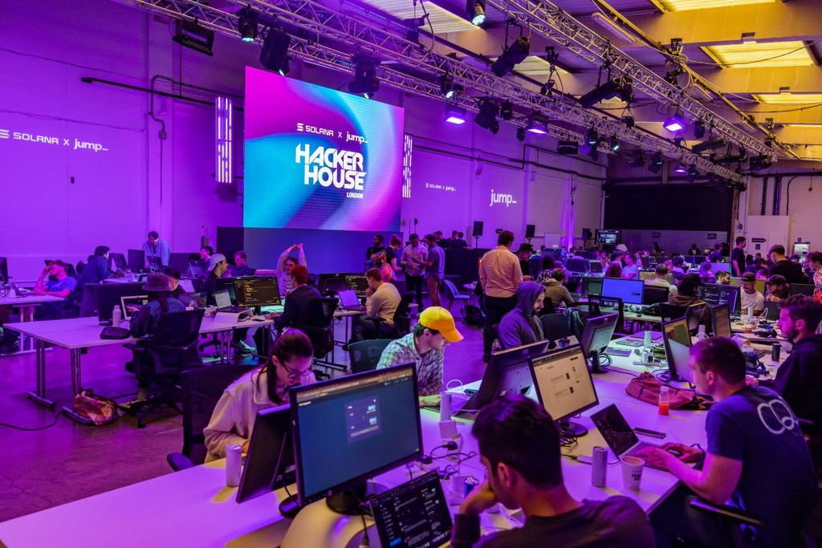
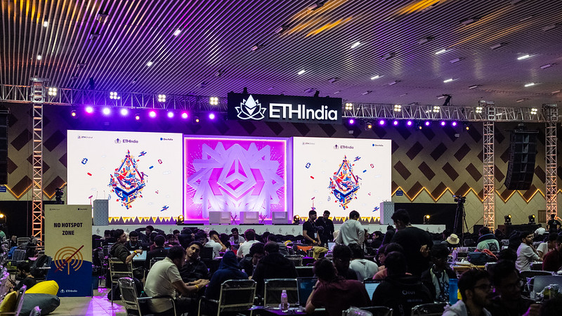
Why You Should Join a
COMMUNITY ?
Hackathons
Conferences & Meetups
Events & Workshops
Bootcamps
Access to Resources & Tools
Personal Growth & Mentorship

Slide 6






Slide 7
Highlights

Slide 8

Core Team
Introduction

Slide 9
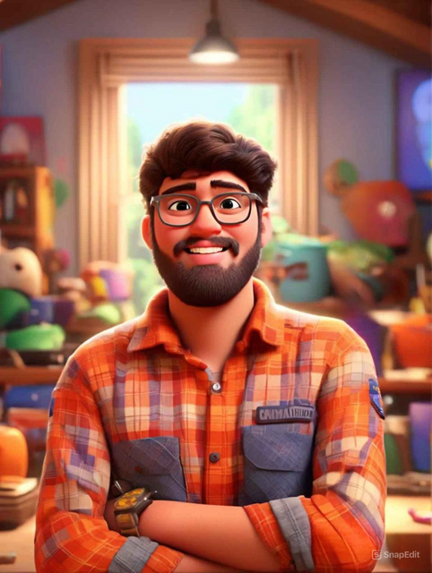


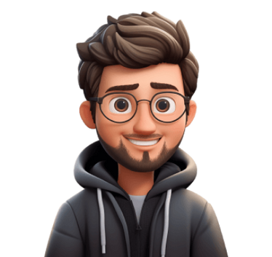
About Me🫣:
Bello, I’m Aryan Gajjar, an aspiring DevRel passionate about building tech communities. I’ve contributed to GDSC, MLSA, Postman and many more.
Research Intern at ISRO, and organised the Hack The Mountains hackathon.
I’m a ‘Bournvita kid’ who loves 🎮 gaming, music, football, watching YT.
Aryan Gajjar
<Organizer>

Slide 10
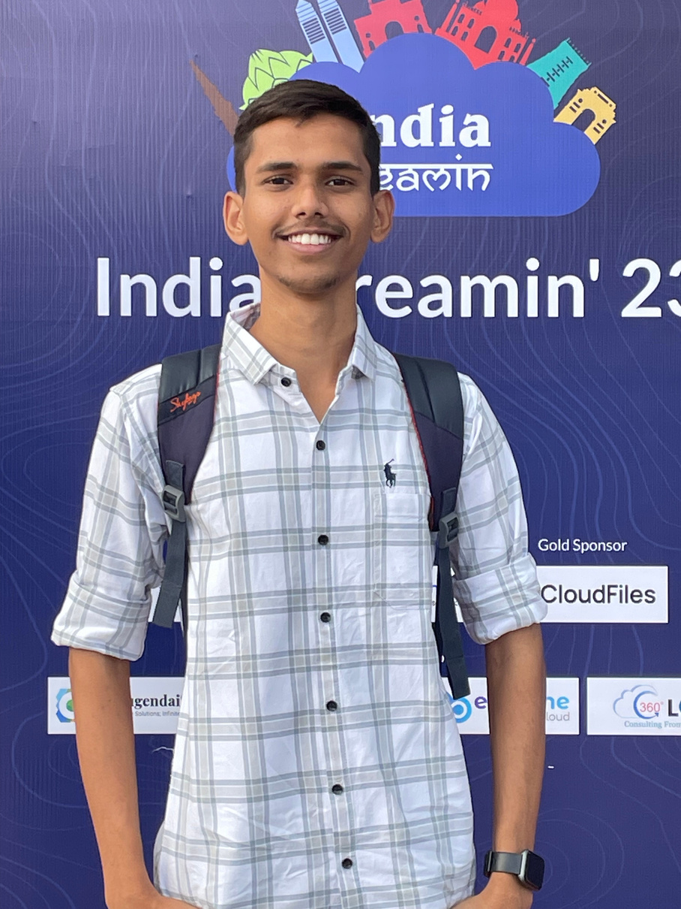


About Me:
Hello! I'm Khushal Khandelwal, an engineering student with a strong interest in programming and technology.
I enjoy working on projects that challenge my skills. I'm curious, always eager to learn and explore cool stuff.
I love to explore new technologies and stay updated with the latest trends in the tech world. I also enjoy scrolling reels and watching Sci-Fi Movies.
Khushal Khandelwal
<Core Team>

Slide 11
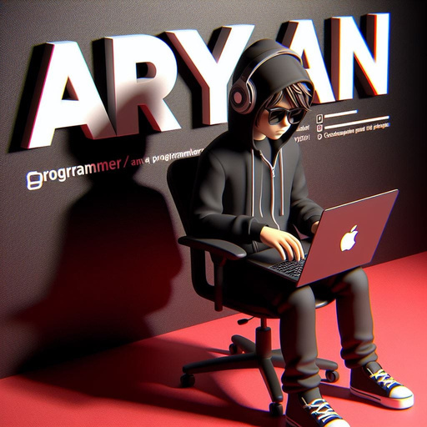

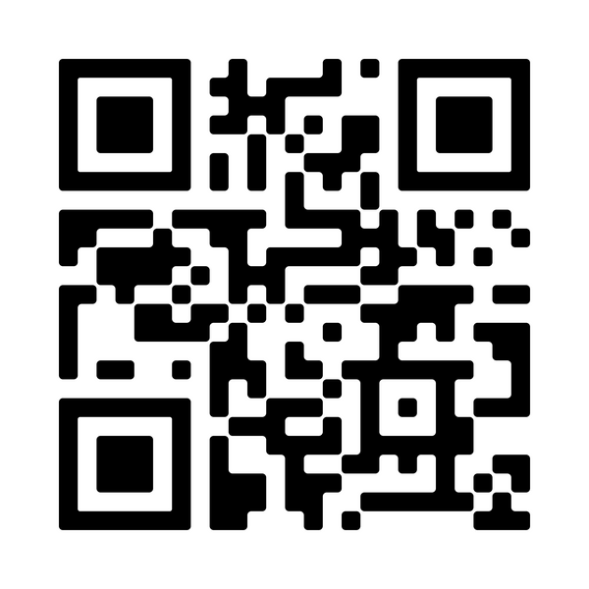
About Me:
I’m a self-taught developer with a passion for building exciting projects.
With over 1500 contributions to my name, I’ve created several MVPs and love experimenting with new ideas. 💻✨
On weekends, you’ll often find me crafting cool projects or diving into new tech stacks—like that one time I rewrote an entire codebase just for the thrill! 😄
Aryan Bhati
<Core Team>

Slide 12
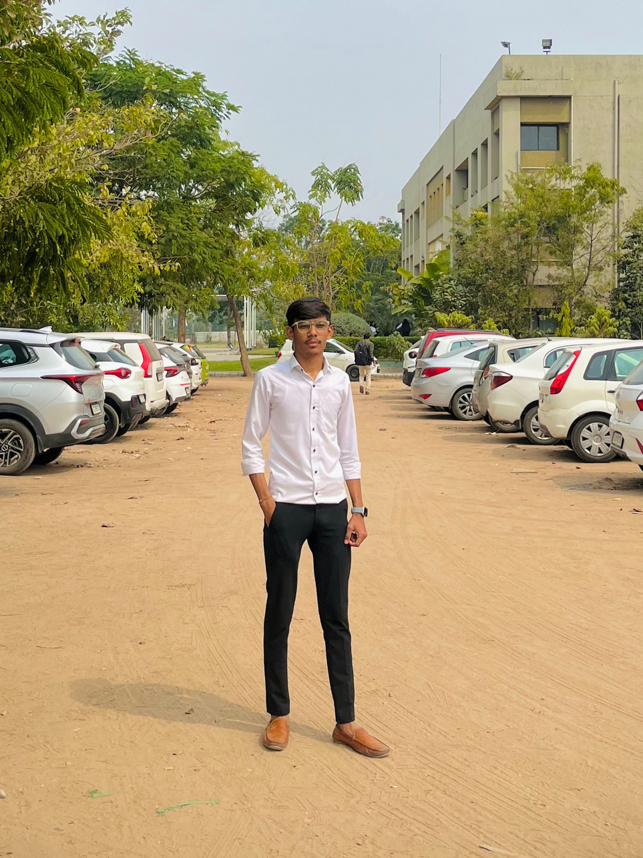

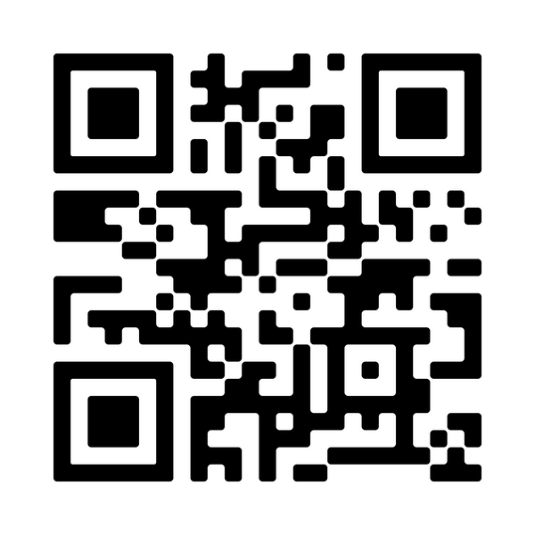
About Me:
I'm Jalp Patel, a passionate individual dedicated to using technology for positive change. I engage in hackathons, tech projects, and developer communities to drive innovation and leadership.
I dive into new interests, from coding challenges to exploring unique aspects of history.
Jalp Patel
<Core Team>

Slide 13
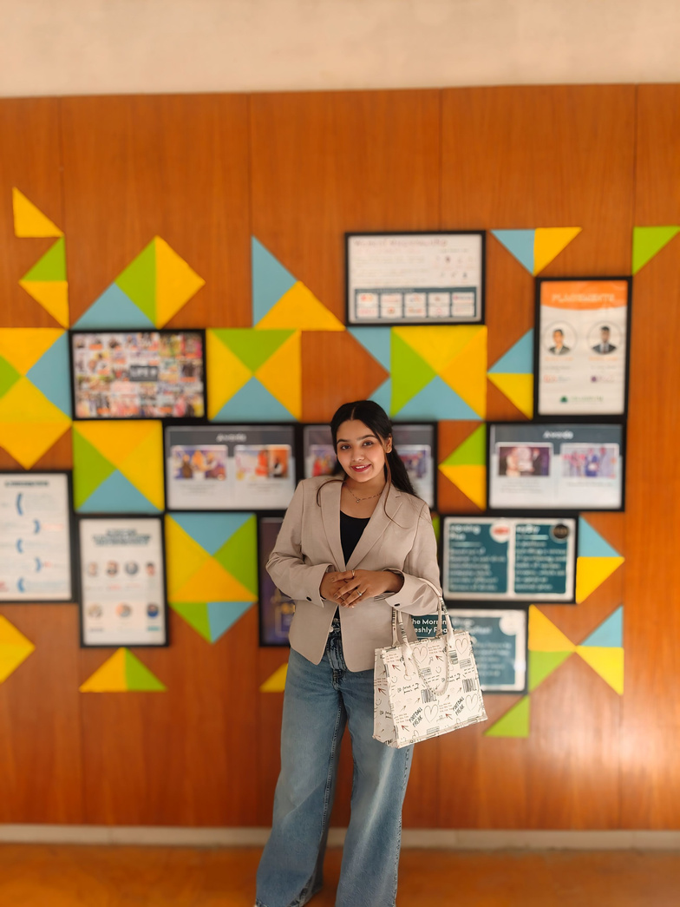

About Me:
I’m Preksha Prajapati, a passionate learner with a focus on Cloud Computing and DevOps.
I'm an AWS-certified and a Core Team Member at GDG. I thrive in solving complex problems.
I once crashed my Wi-Fi while experimenting with a DIY smart home project.
Preksha
<Core Team>

Slide 14
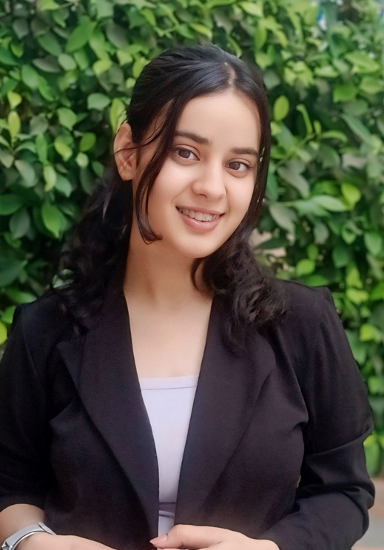

About Me:
I'm Jasmeet Kaur, an AFS India alumna and active volunteer with the Gandhinagar chapter, fostering cultural exchange and learning. My exchange journey broadened my perspective, and I’ve mentored a student from the Netherlands.
I’ve traveled across 23 U.S. states!
I love drawing, cooking, playing musical instruments, binge-watching cultural series, and traveling.
Jasmeet
<Core Team>

Slide 15
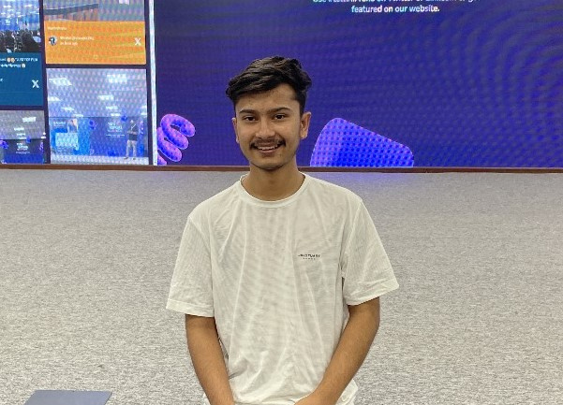

About Me:
I love turning ideas into impactful projects, from AI-driven solutions.
FullStack Intern at Kidjig Pvt Ltd, and love exploring new ideas.
I once debugged code during a cricket match—tech meets multitasking!.
Arjun
<Core Team>

Slide 16
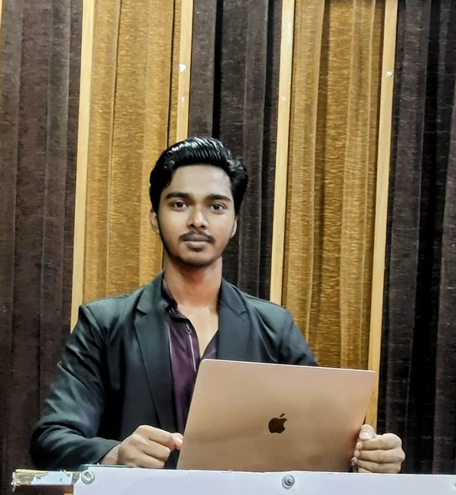
About Me:
I’m Yug Singh, a full-stack developer passionate about building impactful solutions and solving complex problems.
Recently, explored my first hackathon and built belongify.
Chess ♟️ enthusiast, badminton player. Known for my wit, humor, and positive energy! 🚀
Yug Singh
<Core Team>

Slide 17
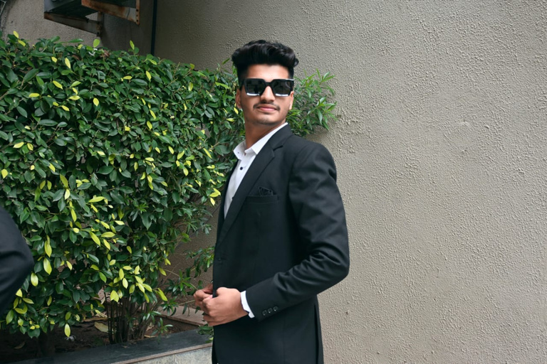

About Me:
Hey there! I’m Prathviraj Soni, a passionate developer and lifelong learner who thrives on challenges.
With coding, design, and team management expertise, I’m driven by growth and collaboration. 💡
Badminton enthusiast 🏸, music lover 🎵, and movie buff. I bring positivity to every team I’m part of.
Prathviraj Soni
<Core Team>

Slide 18
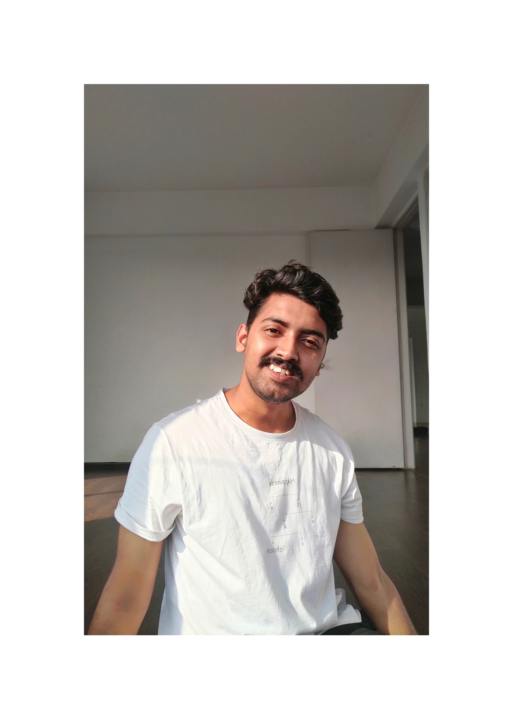

About Me:
I’m Vishal, a self-trained developer and data enthusiast, creating impactful content as part of GDG On Campus SSIU.
With a background in entrepreneurship, I excel in leadership, teamwork, and building meaningful projects.
Outside coding, I’m a movie buff 🎥, travel lover 🌍, and mentor who’s guided 20+ students. I once coded in a scenic café! ☕
Vishal
<Core Team>

Slide 19
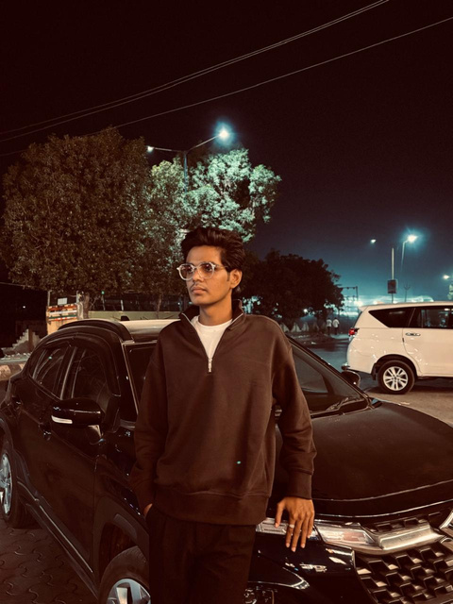

About Me:
I'm Aman Kadiwala, a tech enthusiast passionate about turning ideas into solutions.
I’m fascination with how things work led him to explore complex systems and create impactful projects. Outside of tech.
I can fix your gadget before you even explain the issue!
Aman
<Core Team>

Slide 20


FUN ACTIVITY
Time!!
LET’S PLAY!

Slide 21
Welcome to a club
where we ain't gonna judge a fish
by its capability to climb a tree
just judge you by the ability to solve coding problems to a certain degree..

Slide 22

Upcoming Events?

Slide 23


Solution Challenge 2025
AI for a Better Tomorrow

Slide 24
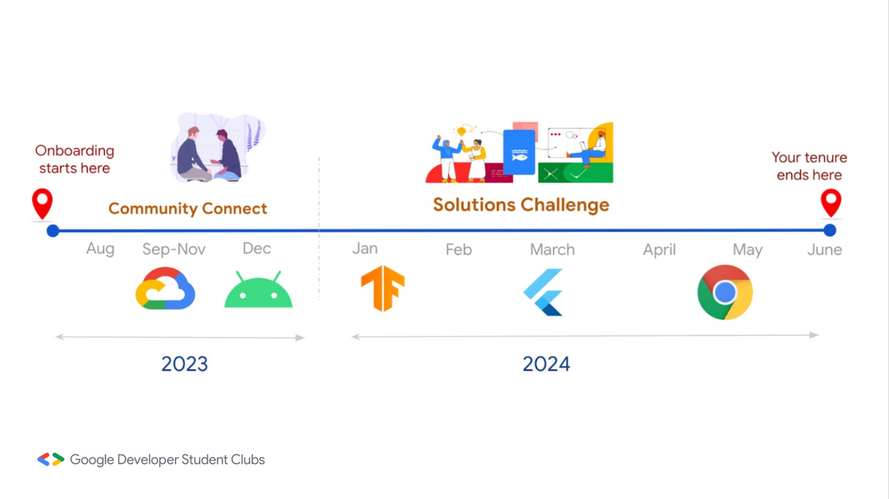

Jan
Feb
March
April
May
June
July..

Slide 25
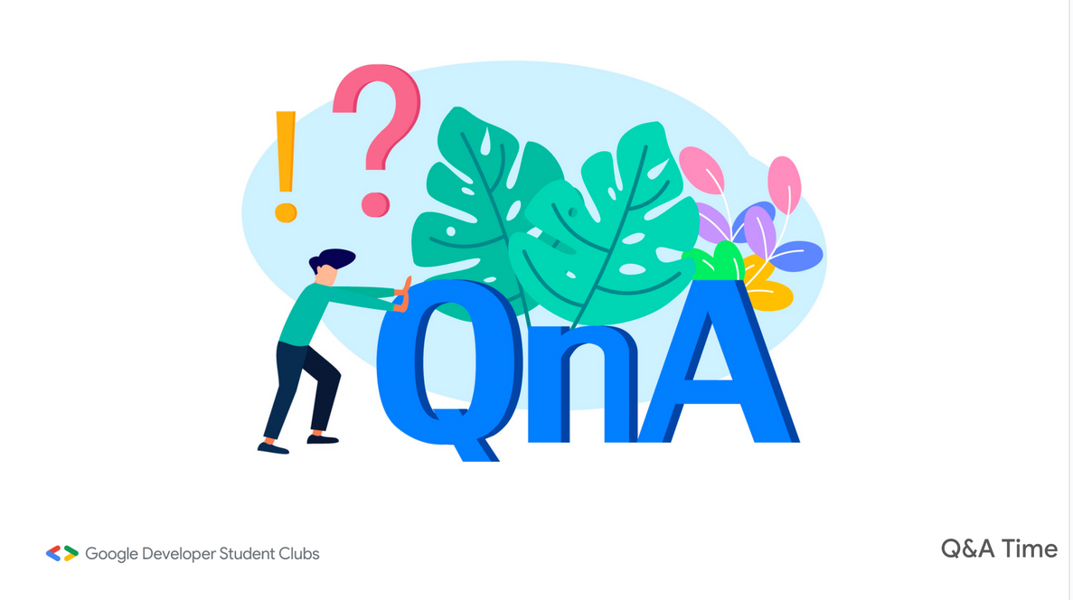

Slide 26

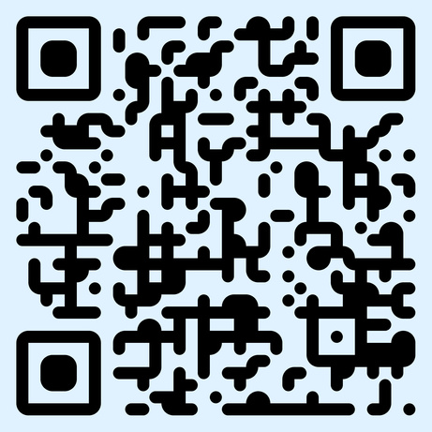
Stay connected...!

